Slide 1
Exploring Generative Models: StyleGAN and CycleGAN Analysis

Slide 2
StyleGAN vs. Vanilla GAN
The key differences that categorize StyleGAN as distinct from vanilla GANs are:
Progressive Growth: StyleGAN uses progressive growing of both the Generator and the Discriminator, starting with low-resolution images and adding resolution stages, which is not typically seen in vanilla GANs.
Adaptive Instance Normalization: The use of AdaIN allows StyleGAN to control the style of generated images more effectively, creating high-quality, diverse, and customizable results.
Equalized Learning Rates: StyleGAN ensures that weights in different layers have equalized learning rates, making training more stable and efficient.
Noise Injection: The introduction of noise at various layers in the Generator adds a level of randomness, resulting in more natural-looking images.
Gradient Penalty: StyleGAN uses a gradient penalty to encourage the generator to produce smoother images, contributing to the quality of the generated images.

Slide 3
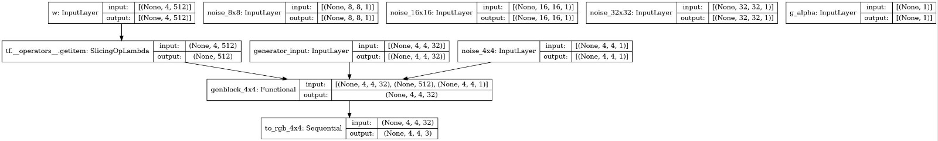
Generator in StyleGAN
Progressive Growth: It starts at a low resolution (e.g., 4x4) and progressively increases the image resolution in stages upto 32X32. It generates images in multiple resolutions and merges them to create higher-resolution images with finer detail.
Adaptive Instance Normalization (AdaIN): Instead of standard normalization techniques, StyleGAN employs AdaIN. It takes a style code (learned from the input noise) and adapts the normalization parameters for each layer individually. This allows for more precise control over the style of the generated image, making it possible to create diverse and high-quality images.
Noise Injection: Noise is added at different layers of the Generator. This noise helps in introducing randomness and can create variations in the generated images, making them appear more natural.
Equalized Learning Rates: Equalized convolution and dense layers are used to ensure that the learning rates of weights in different layers are normalized. This technique helps stabilize training and allows for more efficient optimization.

Slide 4
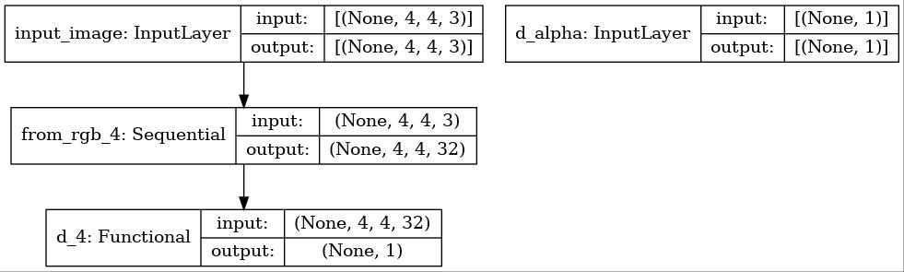
Discriminator in StyleGAN
The StyleGAN Discriminator is also designed with progressive growth, making it capable of evaluating images at different resolutions. Key components include:
Progressive Growth: Similar to the Generator, the Discriminator evaluates images at multiple resolutions to provide more accurate feedback.
Gradient Penalty: StyleGAN uses the Wasserstein GAN loss, and it incorporates a gradient penalty to encourage the generator to produce smoother images. This is an improvement over traditional GANs, as it helps control the quality of generated images.
Minibatch Standard Deviation: Used to improve the stability of training by introducing a form of diversity within the

Slide 5
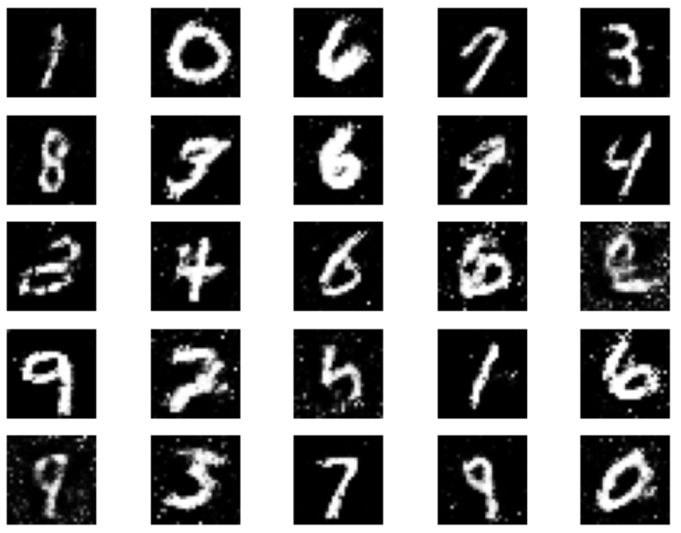
Previous output with Vanilla GAN

Slide 6
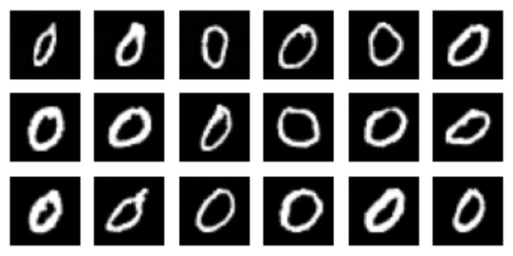
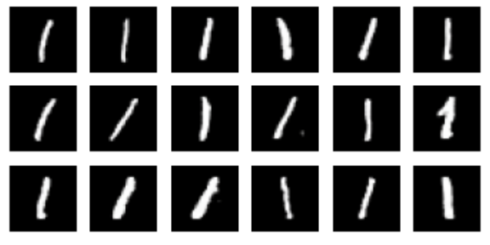
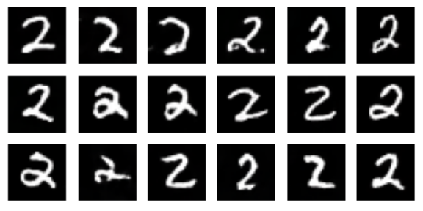
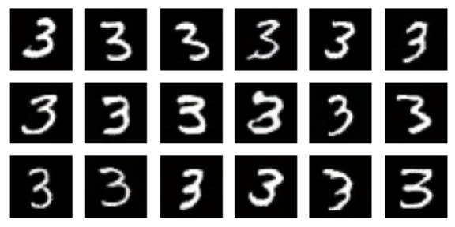
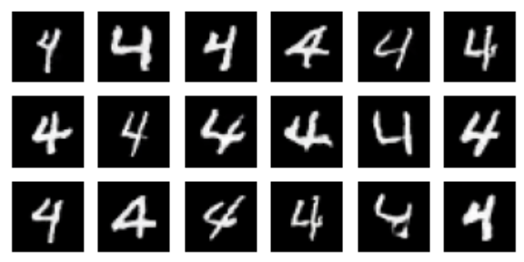
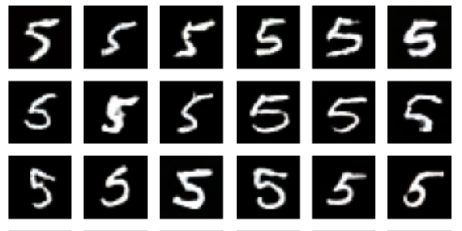
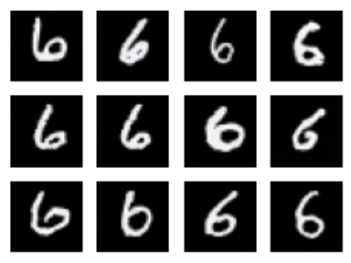
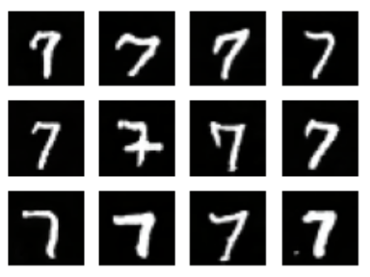
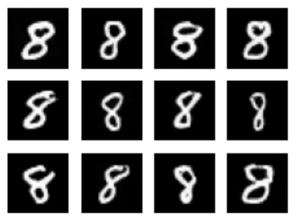
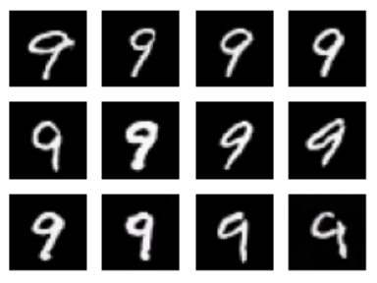
Improvement with Style GAN

Slide 7
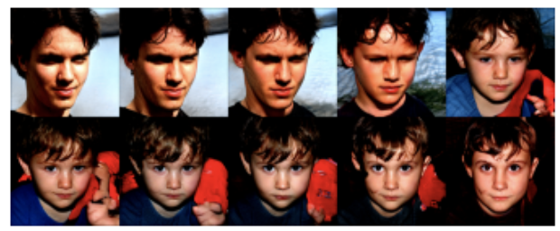

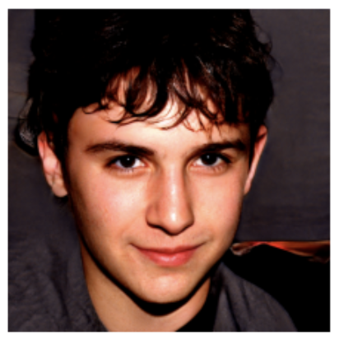
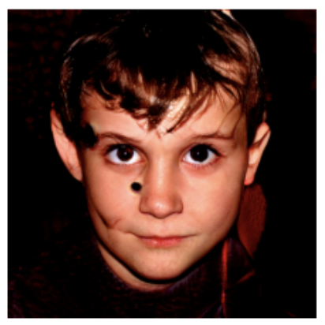
Output using pre-trained weights
first random latent vector + generate first image
second random latent vector + generate second image

Slide 8
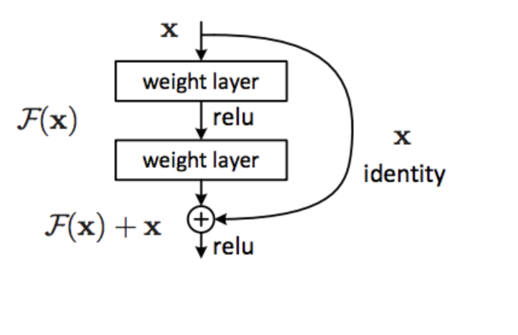
Cycle GAN
The overall generator is the same as the previous generator used in pixel to pixel GAN, but this time the generator has a New Residual block. Let's create this Residual Block, this residual block has the 2 set Convolutional layer followed by instance normalization, which is in last followed by a Skip Connection.
The residual network uses a stride = 1. That means it does not decreases the size of the input image. All it does is it learns the features of the image.

Slide 9
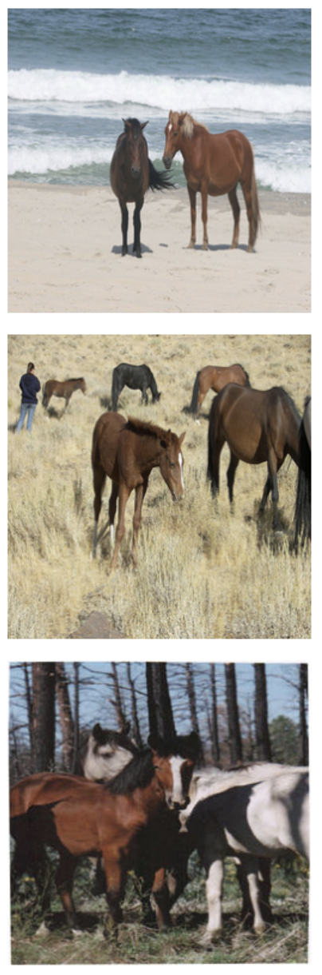
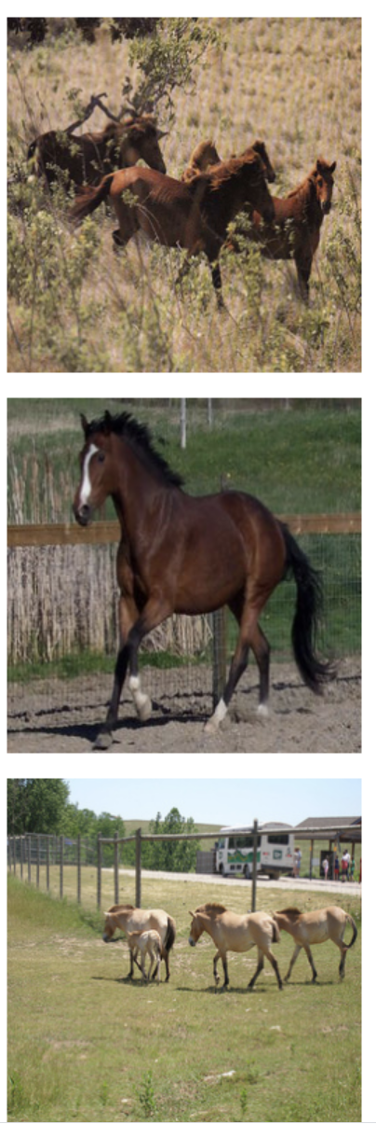
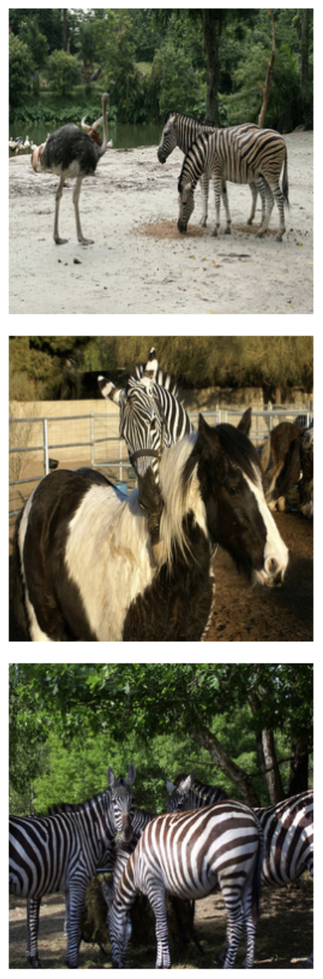
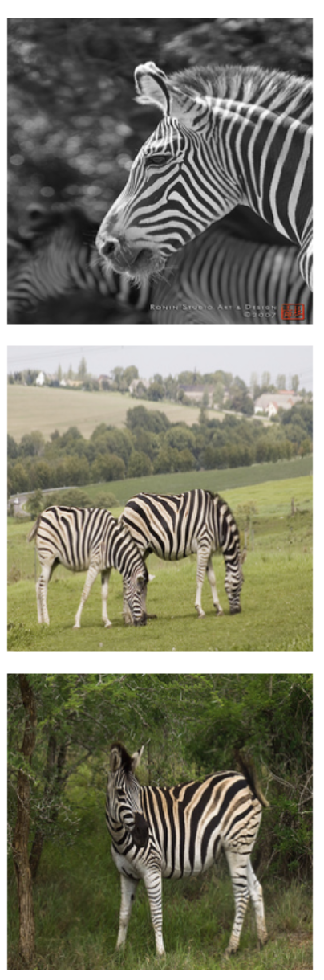
Visualizing the images
in both Horse and
Zebra dataset

Slide 10
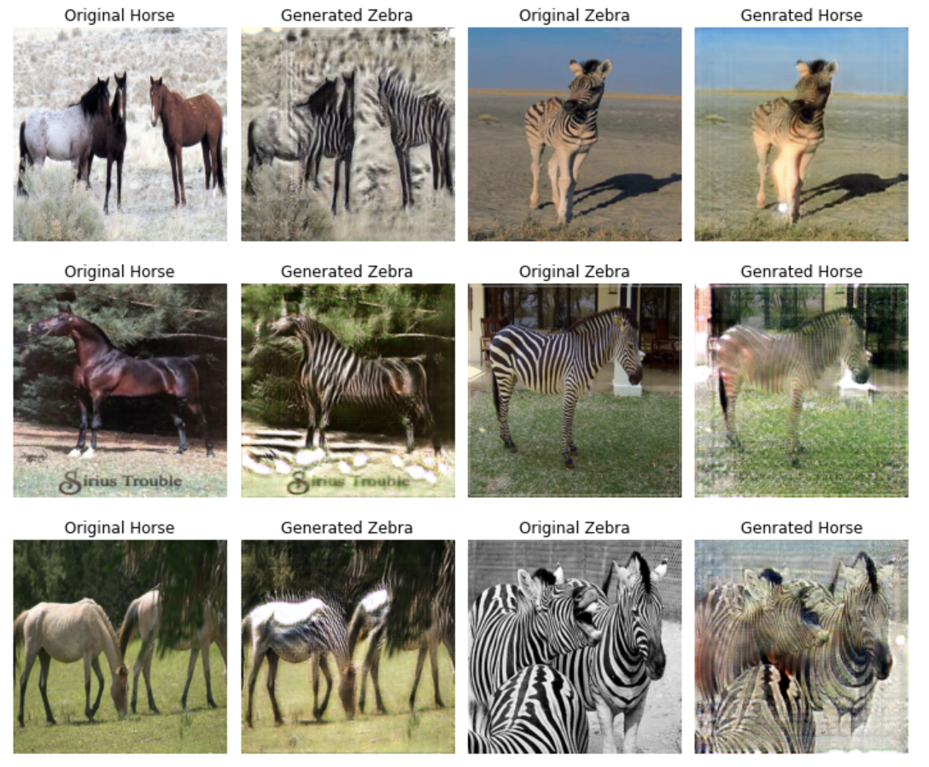
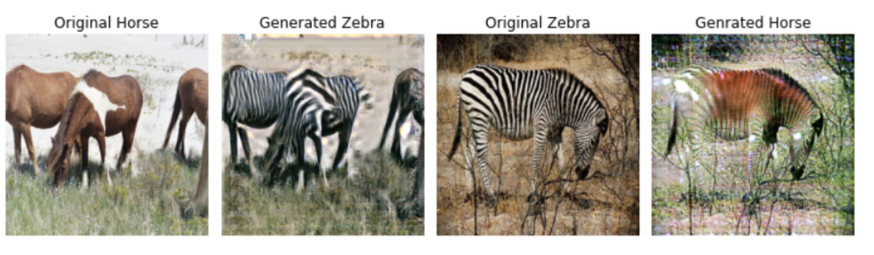
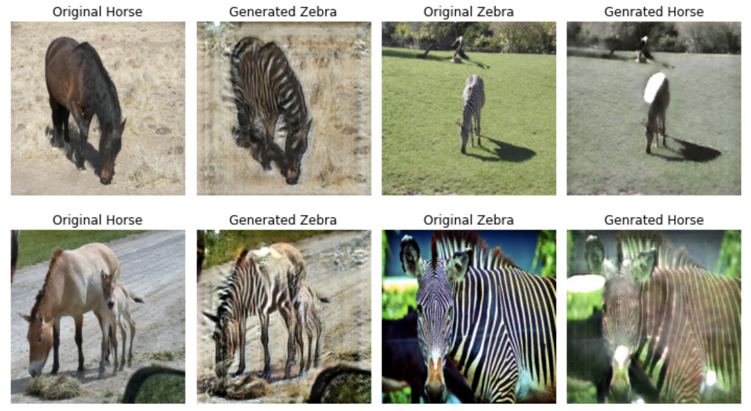
After 25 epochs

